Slide 1
Static Timing Analysis
Song Chen
Dept. of Electronic Science and Technology
Oct. 22, 2015
http://staff.ustc.edu.cn/~songch/da-ug.htm

Slide 2
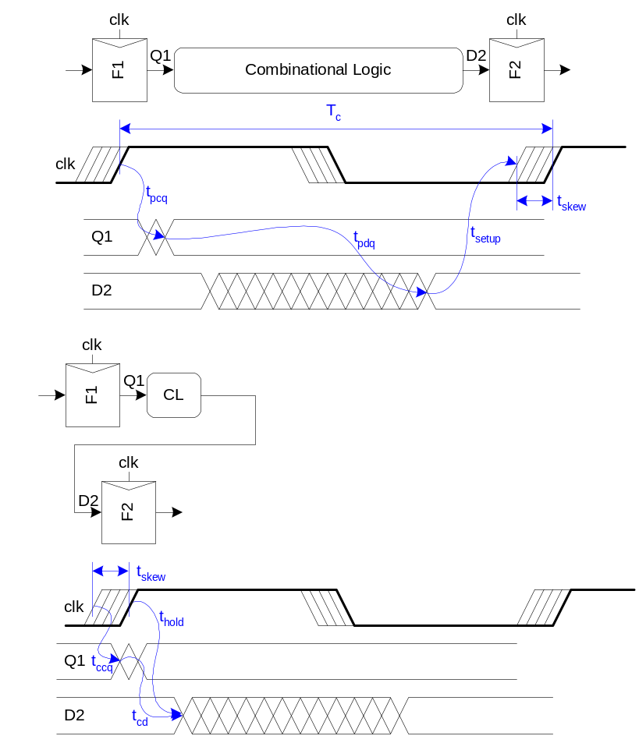
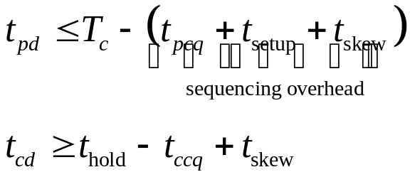
Skew: Flip-Flops

Slide 3
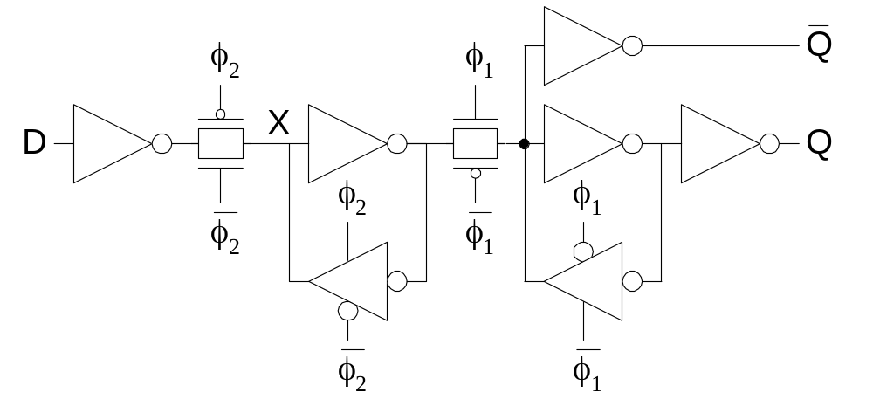
Safe Flip-Flop
In industry, use a better timing analyzer
  Add buffers to slow signals if hold time is at risk
  Pls. refer to [1].Chapter 10.3 for the circuit design of flip-flops and latches.

Slide 4
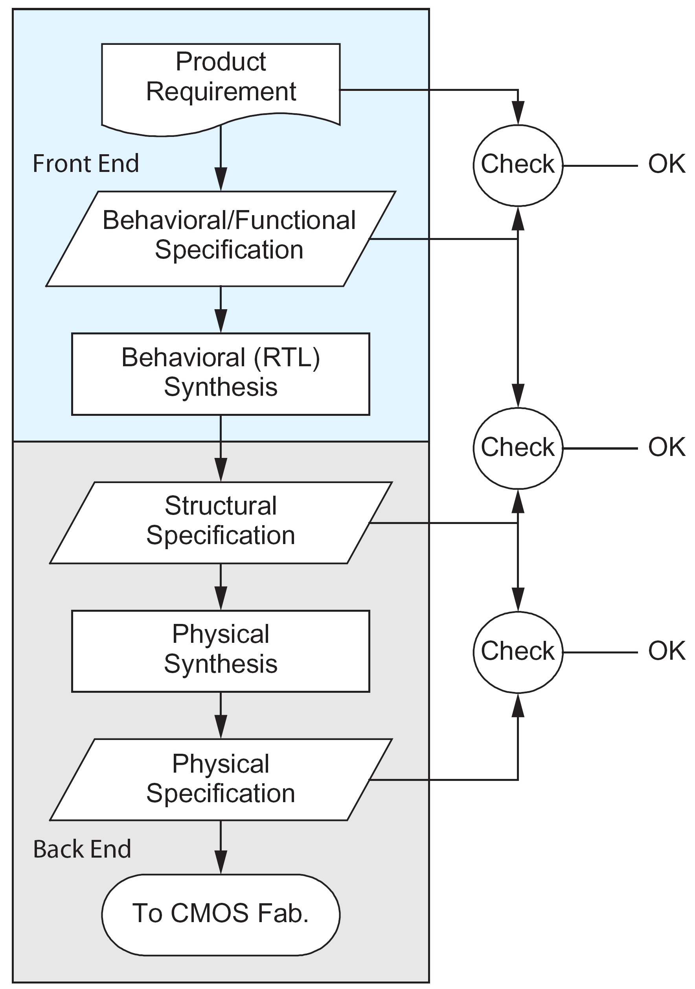
STA in ASIC Design Flow
Static Timing Analysis

Slide 5
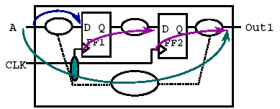
Three Steps in Static Timing Analysis
Circuit is broken down into sets of timing paths
Delay of each path is calculated
Path delays are checked to see if timing constraints have been met

Slide 6
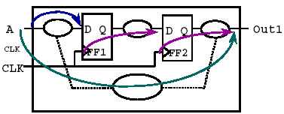
Timing Path
A Timing Path is a point-to-point path in a design which can propagate data from one flip-flop to another
  Each path has a start point and an endpoint
  Start point: Input ports, Clock pins of flip-flops
  End points: Output ports, Data input pins of flip-flops

Slide 7
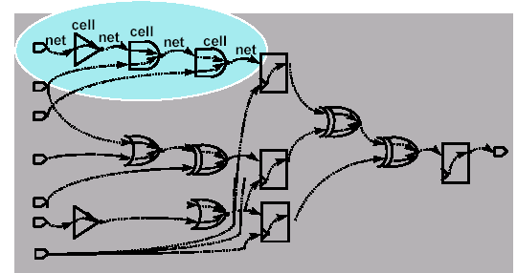
Net and Cell Timing Arcs
The actual path delay is the sum of net and cell delays along the timing path

Slide 8
Net and Cell Delay
“Net Delay” refers to the total time needed to charge or discharge all of the parasitics of a given net
  Total net parasitics are affected by
    net length
    net fanout
  Net delay and parasitics are typically
    Back-Annotated (Post-Layout) from data obtained from an extraction tool
    Estimated (Pre-Layout), wireload model
      E.g., dc_shell in -topograchical mode

Slide 9
Slack and Critical Path
Slack
  It is the difference between the required (constraint) time and the arrival time (inputs and delays).
  Negative slack indicates that constraints have not been met, while positive slack indicates that constraints have been met.
  Slack analysis is used to identify timing critical paths in a design by the static timing analysis tool
Critical path
  Any logical path in the design that violates the timing constraints
  Path with a negative slack

Slide 10
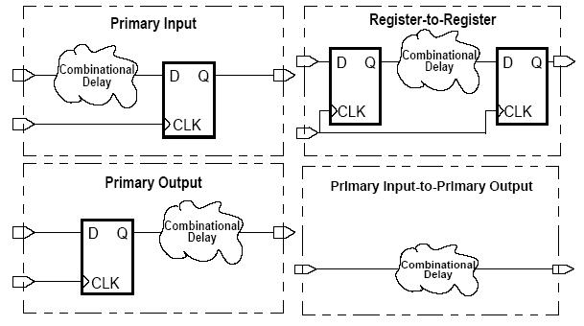
Slack Analysis – Data Path Types

Slide 11
Slack Analysis – Data Path types
Primary input-to-register paths
  Delays off-chip + Combinational logic delays up to the first sequential device.
Register-to-primary output paths
  Start at a sequential device
  CLK-to-Q transition delay + the combinational logic delay + external delay requirements
Register-to-register paths
  Delay and timing constraint (Setup and Hold) times between sequential devices for synchronous clocks
Primary input-to-primary output paths
  Delays off-chip + combinational logic delays + external delay requirements.

Slide 12
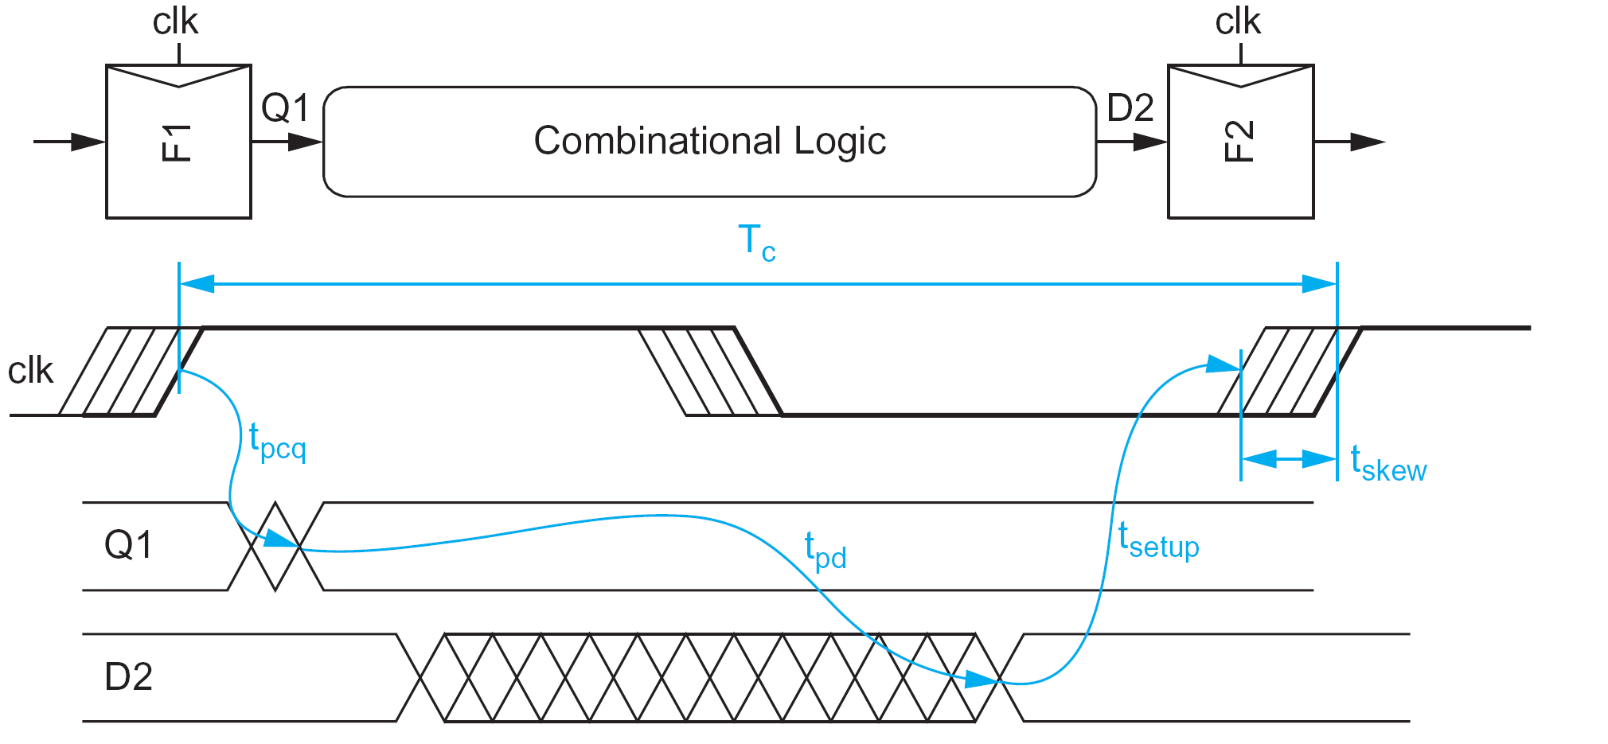





Setup Slack Calculation
Required time
Arrival time
Slack

Slide 13
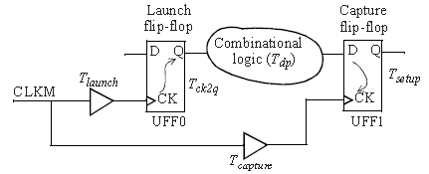
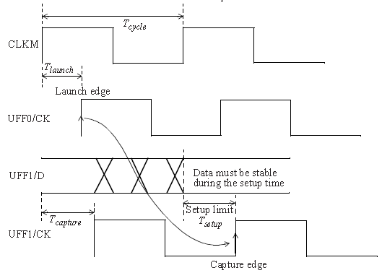
Setup Slack Calculation
Arrival time
Required time

Slide 14
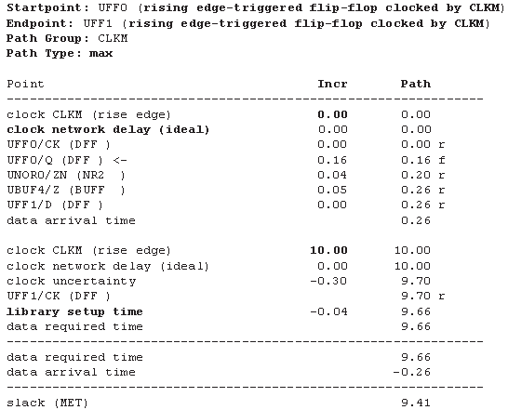
Example of Setup Check

Slide 15
Computation of path delay
Combinational circuit as DAG
a
(0.15)
y (2)
(0.2)
w (2)
(0.2)
f
(0.1)
b
(0.1)
x (1)
(0.3)
(0.25)
z (2)
c
(0.1)
a (0)
(0.15)
y (2)
(0)
(0.1)
(0.2)
s
(0)
b (0)
(0.1)
x (1)
w (2)
(0.2)
f (0)
(0.6)
(0.3)
(0.25)
c (0)
(0.1)
z (2)

Slide 16
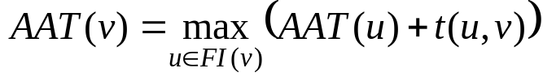
Computation of path delay
Compute AATs at each node:
where FI(v) is the fanin nodes, and t(u,v) is the delay between u and v
(AATs of inputs are given)
a (0)
(0.15)
y (2)
A 0
A 3.2
(0)
(0.1)
(0.2)
s
(0)
b (0)
(0.1)
x (1)
w (2)
(0.2)
f (0)
A 0
A 0
A 1.1
A 5.65
A 5.85
(0.6)
(0.3)
(0.25)
c (0)
(0.1)
z (2)
A 0.6
A 3.4

Slide 17
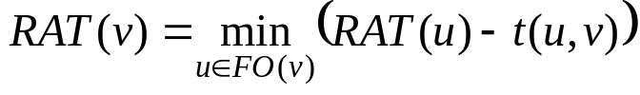
Computation of path delay
Compute RATs at each node:
where FO(v) are the fanout nodes, and t(u,v) is the delay between u and v
(RATs of outputs are given)
a (0)
(0.15)
y (2)
R 0.95
R 3.1
(0)
(0.1)
(0.2)
s
(0)
b (0)
(0.1)
x (1)
w (2)
(0.2)
f (0)
R -0.35
R -0.35
R 0.75
R 5.3
R 5.5
(0.6)
(0.3)
(0.25)
c (0)
(0.1)
z (2)
© 2011 Springer Verlag
R 0.95
R 3.05

Slide 18

Computation of path delay
Compute slacks at each node:
a (0)
(0.15)
y (2)
A 0
R 0.95
S 0.95
A 3.2
R 3.1
S -0.1
(0)
(0.1)
(0.2)
s
(0)
b (0)
(0.1)
x (1)
w (2)
(0.2)
f (0)
A 0
R -0.35
S -0.35
A 0
R -0.35
S -0.35
A 1.1
R 0.75
S -0.35
A 5.65
R 5.3
S -0.35
A 5.85
R 5.5
S -0.35
(0.6)
(0.3)
(0.25)
c (0)
(0.1)
z (2)
A 0.6
R 0.95
S 0.35
A 3.4
R 3.05
S -0.35
© 2011 Springer Verlag

Slide 19


Hold Time Check

Slide 20
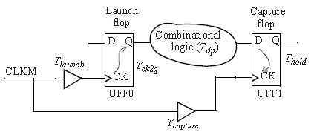
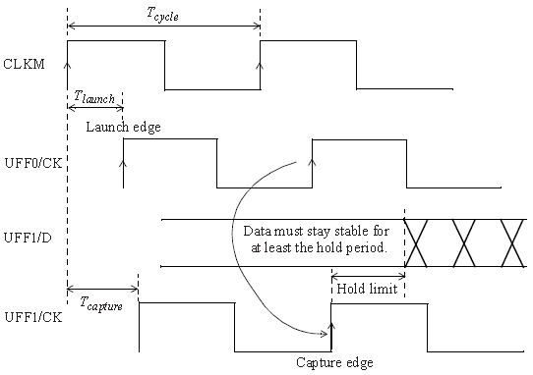
Hold Timing Check
Arrival time
Required time

Slide 21
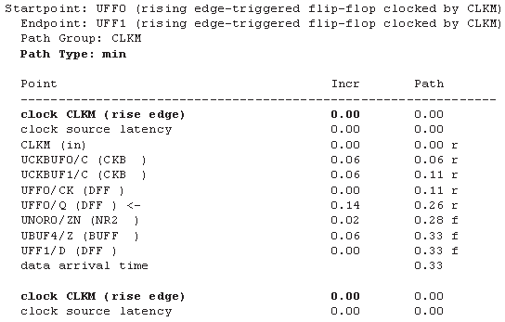
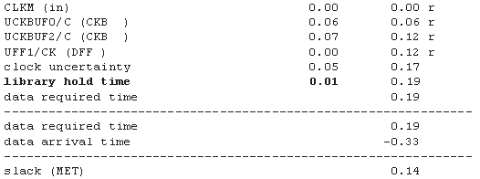
Hold Check Example

Slide 22
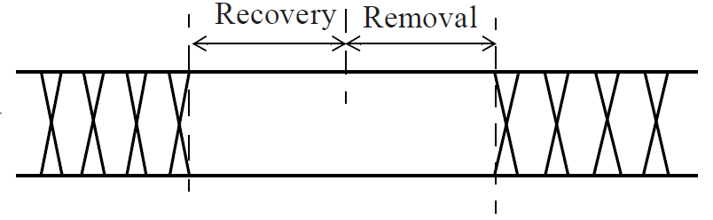
Recovery and Removal Time
Recovery Time
  Like setup time for asynchronous port (set, reset)
  It is the time available between the asynchronous signal going active and the active clock edge
Removal Time
  Like hold time for asynchronous Port (set, reset)
  It is the time between active clock edge and asynchronous signal going inactive

Slide 23
Reference
Please see the website.
  http://staff.ustc.edu.cn/~songch/vlsi-cad.htm

Slide 24
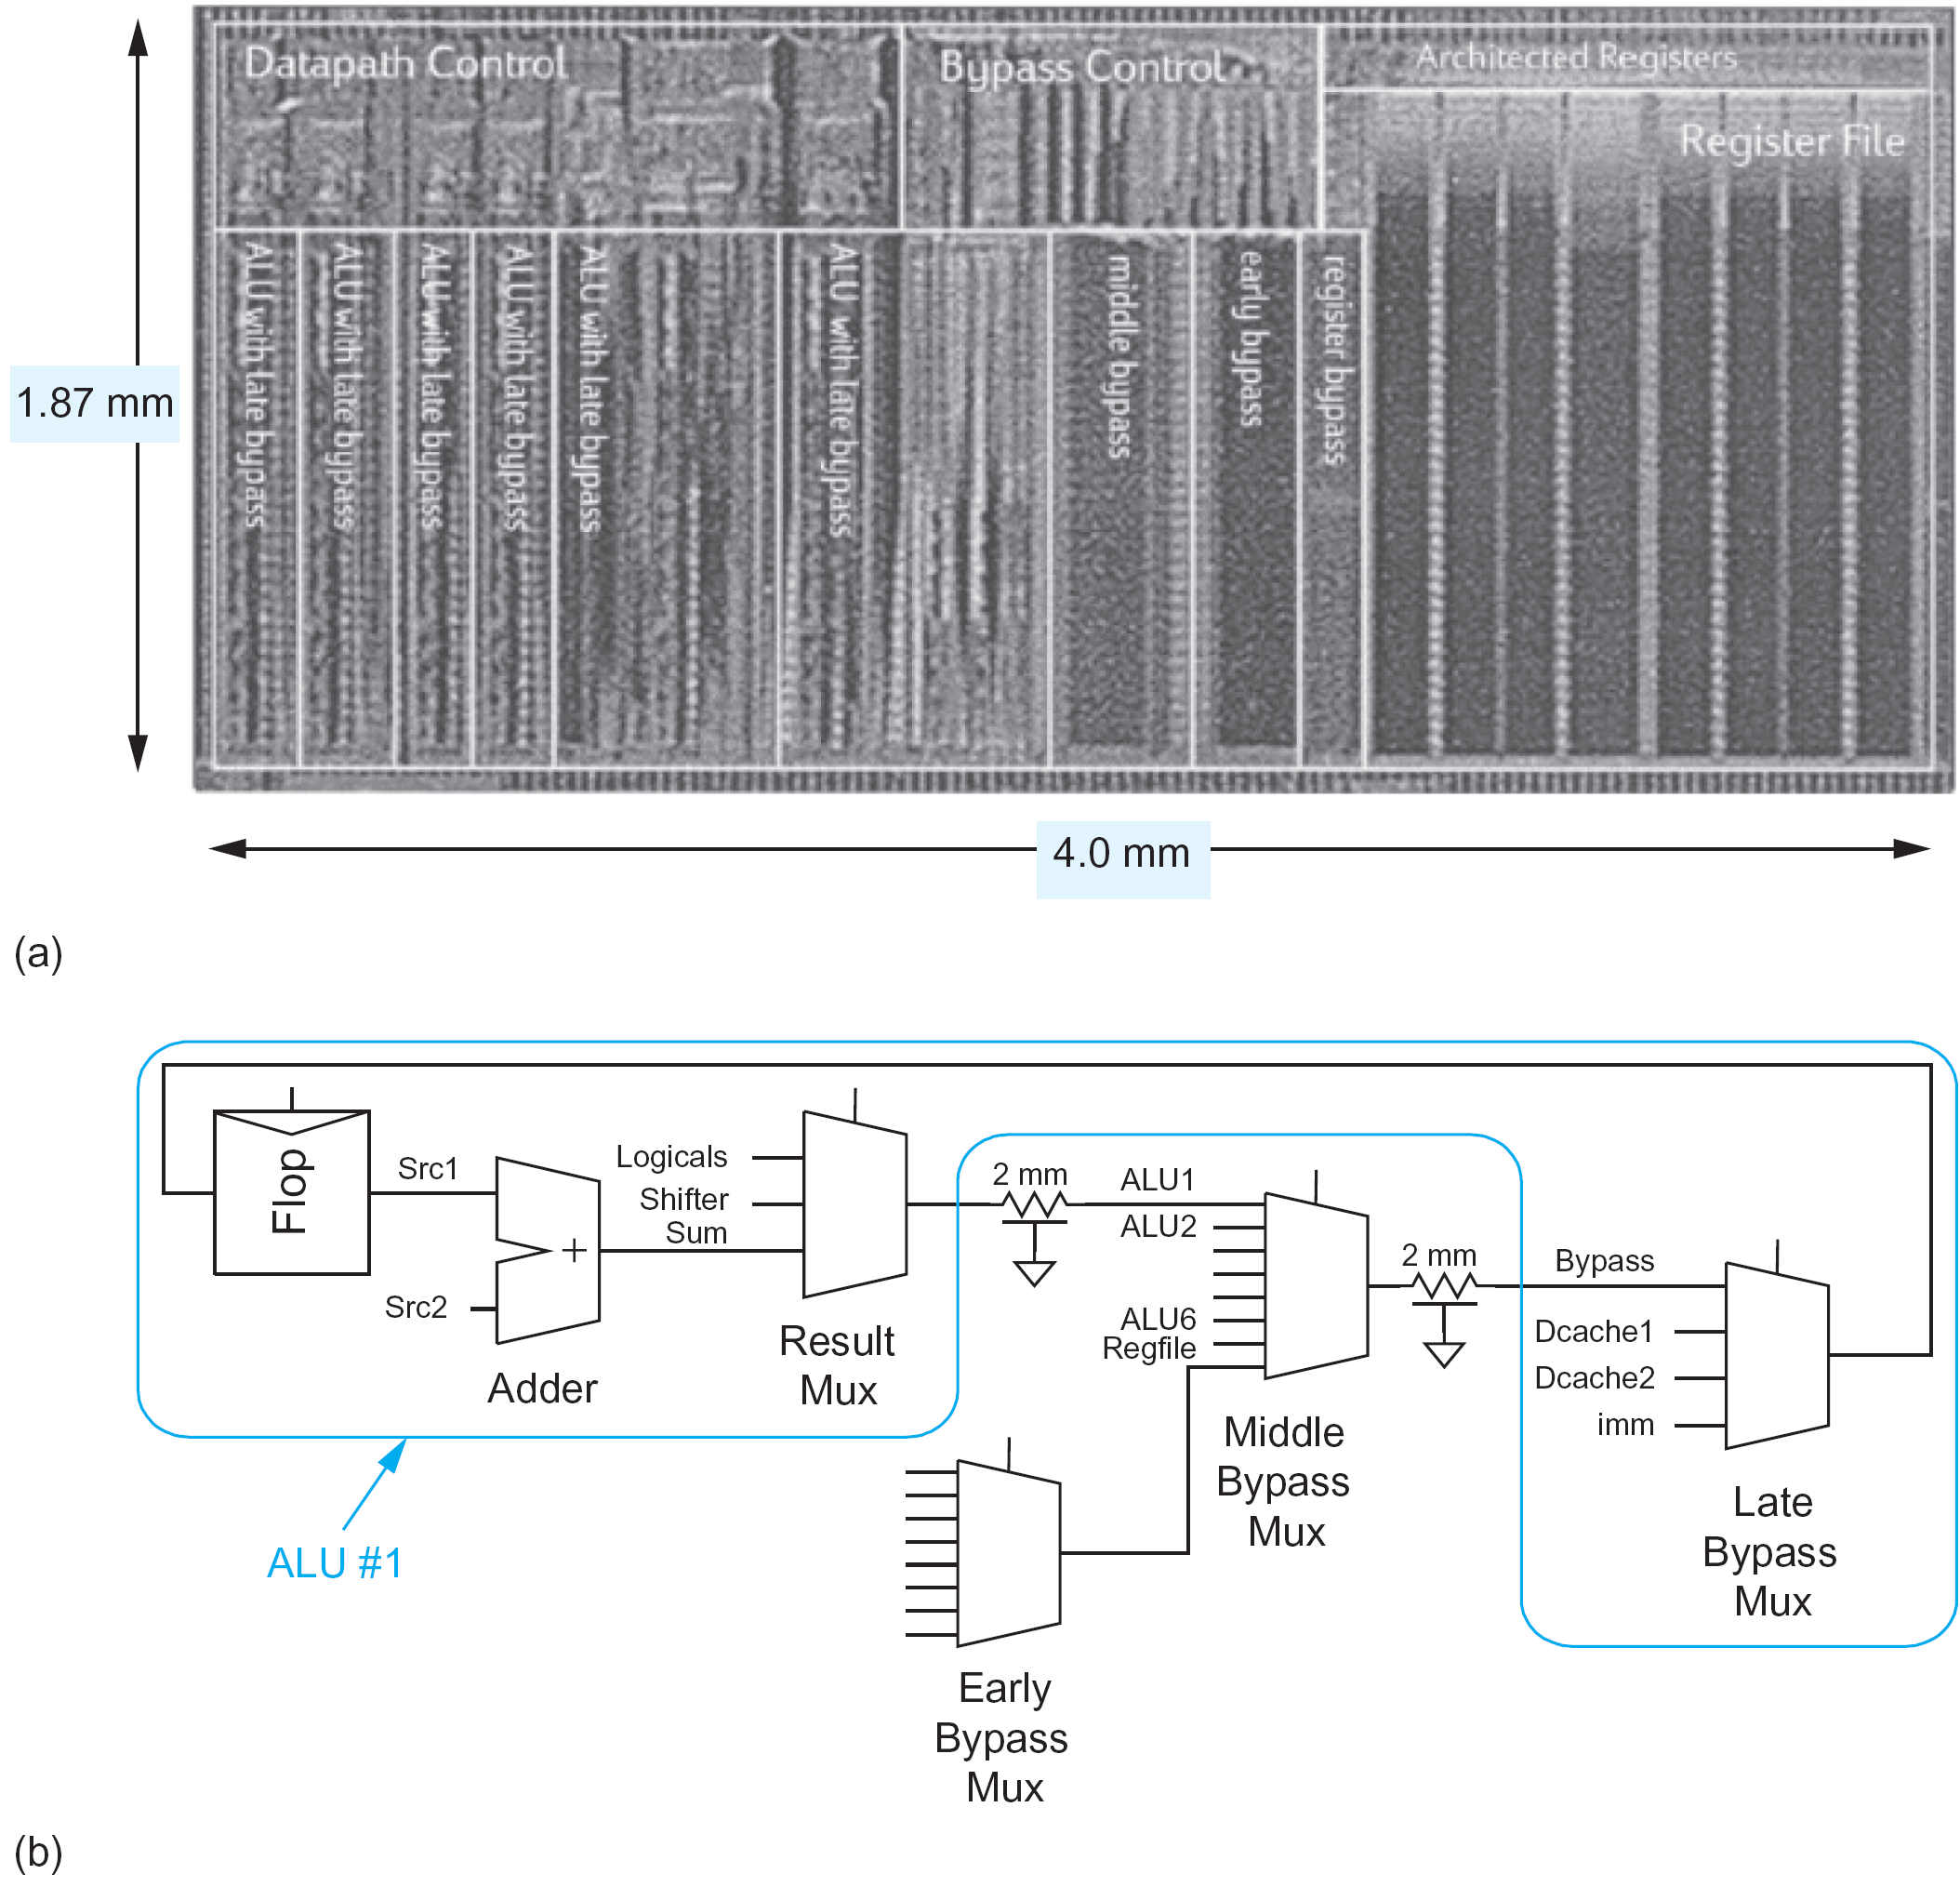
Timing Analysis Exercise
The Integer Execution Unit of the Itanium 2 contains self-bypass paths for six separate ALUs (Arithmetic Logic Unit). The path for one of the ALUs begins at registers (flip-flops) containing the inputs to an adder, as shown in the above figure.
(1) What is the minimum cycle time of the system?
(2) How much clock skew can the system have before hold-time failures occurs?
Pls. see next slide for the timing parameters & delay values.

Slide 25
Timing Parameters & Delays
The propagation delays and contamination delays of the data path components are given in the following Table. Suppose the registers are built from flip-flops with a setup time of 50 ps, hold time of –7 ps, propagation delay of 70 ps, and contamination delay of 60 ps, and the 55 ps clock skew between flip-flops in the various ALUs.
Element | Propagation Delay | Contamination Delay
Adder | 590 ps | 100 ps
Result Mux | 60 ps | 35 ps
Early Bypass Mux | 110 ps | 95 ps
Middle Bypass Mux | 80ps | 55 ps
Late Bypass Mux | 60ps | 45 ps
2-mm Wire | 100 ps | 70ps

